Slide 1

Mobile Computing
Learning Unit 1 1.1 Introduction
Moaath Alrajab

Slide 2
Learning Unit 1
1.1 Introduction
Android History
Android Architecture
Getting Started
1.2 Android Studio
IDE parts
Creating a project
Installing required plugins
1.3 Android Application
Concept and components
Manifest file

Slide 3

What is Android?
Phone Brand
Operating System
Ecosystem
Platform

Slide 4
What is Android?
Android is the world's most popular mobile operating system, powering billions of devices ranging from phones to watches, tablets, TVs, auto, and more.

Slide 5








Some Android History
2003 | Founded by Android Inc.
2005 | Acquired by Google
2007 | Launch of Open Handset Alliance

Slide 6
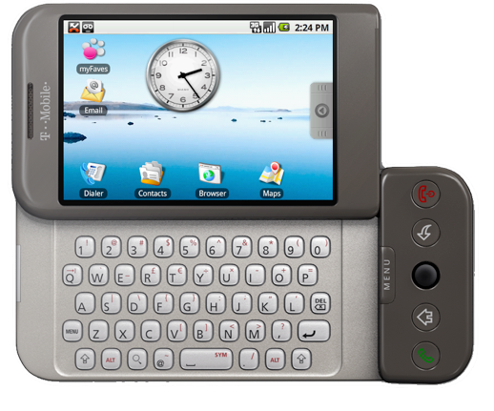
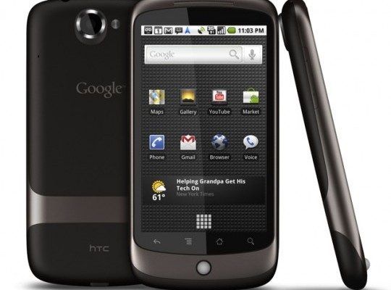
Some Android History
2008 | First Android Device (HTC Dream / G1) 528Mhz ARM 256mb RAM 3.2" screen at 320x480px
2010 | First Nexus Device (Nexus One) 1Ghz Scorpion 512mb RAM 3.7" screen at 480x800px

Slide 7
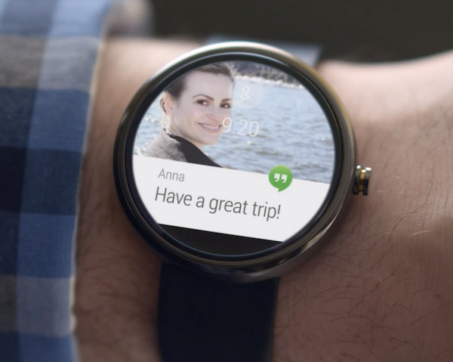
Some Android History
2014 | Android Wear
2015 Android Things - Brillo

Slide 8
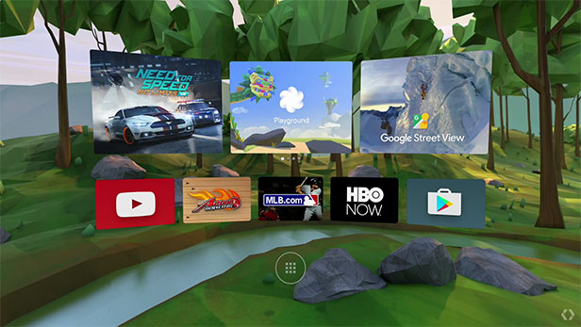
Some Android History
2016 | Daydream ("Android VR")
Also explore Android Auto and Android Chrome https://developer.android.com/chrome-os/intro https://developer.android.com/training/auto/

Slide 9
• Mobile OS market share 2021 | Statista
Popularity
Smartphone operating systems: global market share 2009-2017
Note: Worldwide; 2009 to 2017
• Mobile OS market share 2021 | Statista
Further information regarding this statistic can be found on page 8.
Source: Gartner ID 263453

Slide 10
Android History
Date | Version | Nickname | API Level
Sep 2008 | 1.0 | Android | 1
Apr 2009 | 1.5 | Cupcake | 3
 | …
July 2012 | 4.1 | Jelly Bean | 16
Oct 2013 | 4.4 | KitKat | 19
Nov 2014 | 5.0 | Lollipop | 21
Oct 2015 | 6.0 | Marshmallow | 23
Aug 2016 | 7.0 | Nougat | 24-25
Aug/2017 | 8.0 | Oreo | 26-27
2018 | 9.0 | Android P (Beta 3) | 28
Sept/2019 | 10.0 | Android 10 | 29
Sept/2022 | 13.0 | Android 13 | 33
https://www.android.com/history/

Slide 11
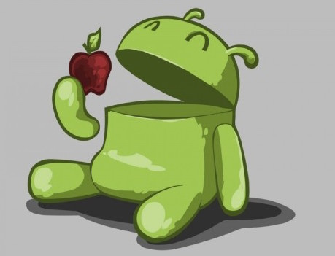

Slide 12
Android Architecture

Slide 13

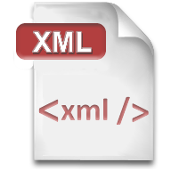
Programming Languages
We will use the following programming languages in this course.
Pre-requisite:
Good Experience
Any Experience
It is good to have
Any Experience

Slide 14
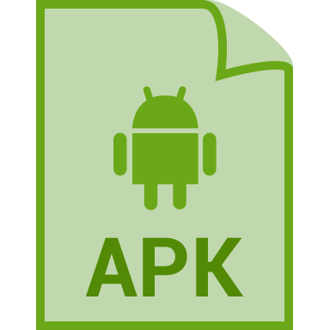
Packaging Apps: APKs
Basically .zip files
Cryptographically signed
"side-load" or upload to Play Store

Slide 15
Building Process
Generate Java source files (e.g. from XML)
Compile Kotlin source into JVM bytecode
"dex" JVM bytecode into Dalvik bytecode (old android)
Pack with graphics and assets into .apk
Cryptographically sign .apk
…
Profit!

Slide 16
Development Hardware
Windows, Mac, or Linux (because Java!)
Physical Android Device
turn on developer options!
Emulator (Virtual Device) available
emulator not great on Windows
use the Intel HAXM for acceleration!

Slide 17
Development Software
Java SDK
Gradle or Apache ANT
Android Studio IDE
Android SDK (command-line tools)
adb "android debugging bridge" connect to devices (physical or virtual)
emulator run the emulator

Slide 18

Next
1.2 Android Studio

Slide 19
When you introduce yourself
What are you most excited about for this class?
What kind of project that you would like do: a game, chat, social networking … be creative!
Say something about your pervious Java experience
Do you have an eye for design?
Maybe project management?
Your ability to write a report and present an ppt?
Planning, prototyping, storyboarding?

